Slide 1
Media Cognition Project Report
Song Chuan Lim, Ziyi Chen, Yudong Xie, Hao Chen
Electronic Engineering Department, Tsinghua University
2024年12月23日

Slide 2
Table of contents
Apriltag & Proposal & Match
Robotic Arm
Audio & Human Interaction
Demo Video

Slide 3
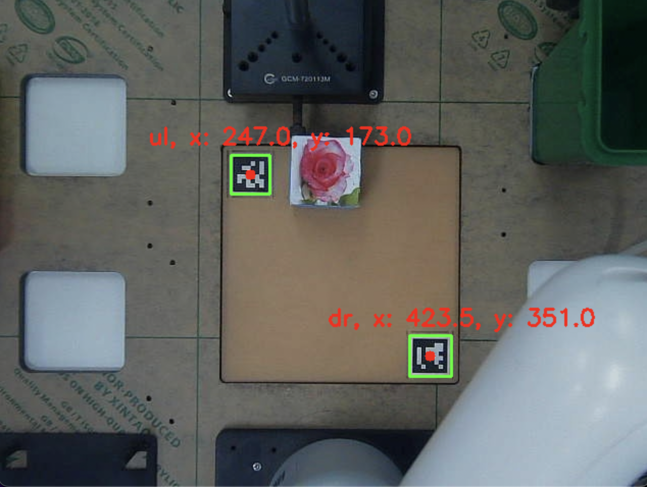
Module Apriltag
Main Function
Detect two-corner AprilTags using template matching.
Input
A single image captured by camera.
Process
Use cv2.matchTemplate to directly match the AprilTag template in the image.
Tricky, but robust!
Compute coordinates.
Output
Center coordinates of AprilTags.
Notes:
Coordinate System

Slide 4
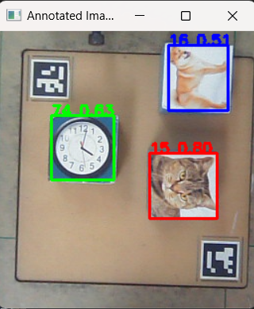
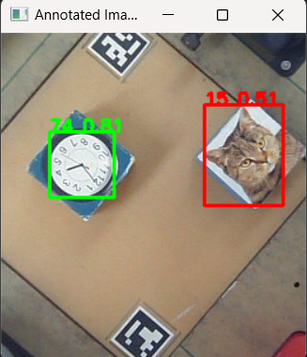
Module Proposal
Main Function
Detect objects in given image using YOLO, robust for orientation by 90°, 180° or 270°
Input
A PIL Image.
Process
Detect objects in the original image using YOLO.
Rotate the image by 90°, 180°, 270° and detect objects at each angle.
Coordinate transformation and deduplication.
Output
Object labels and coordinates in initial coordinate system.
Notes:
Coordinate System

Slide 5
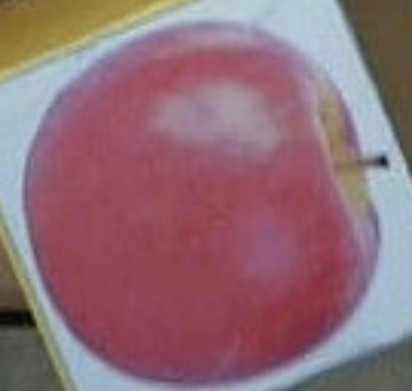
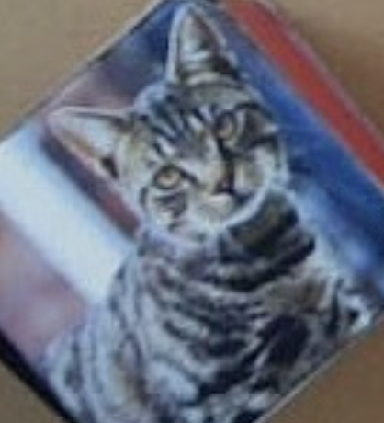
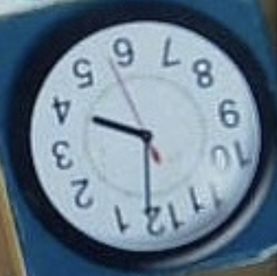

Module Match
Main Function
Identify the best matching image for a given text or the best matching text for a given image using CLIP.
Input
A piece of text with multiple images, or an image with multiple text descriptions.
Process
Encode the input text and images into a shared embedding space using CLIP.
Compute similarity scores between the texts and images using CLIP.
Identify the highest similarity score and its corresponding index.
Output
Index of the most relevant image/text and the similarity score.
Text: Put clock in red bin
Image:
0. 1.
2. 3.
Output:
Max probability: 0.9985 Max index: 2
Notes:
Coordinate System

Slide 6
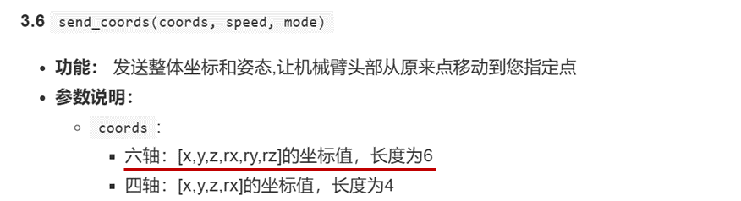
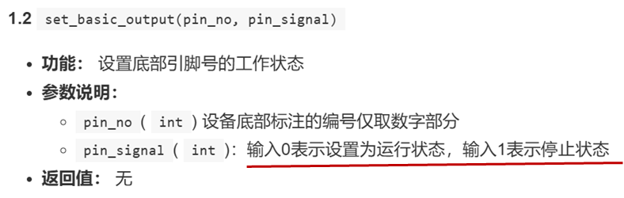
Robotic Arm - Fundamentals
Move
send_coords()
Release the servos, use the function get_coords() to get the coordinates, and record them as fixed parameters.
Cooperate with time.sleep() to realize initialization and path planning.
Core: The coordinate system of the robotic arm and that of the camera and YOLO are different, so the key is to solve the coordinate transformation.
Get & Put
set_basic_output()
The port number of the pump is 2 & 5 (fixed)
Set the parameter to 0 means to open the air pump, and set to 1 means to close the air pump.
Picking up process: Move above the object (via transfer point) --> Descend while turning on the air pump --> (Suck it up) Rise to a certain height
Placing down process: Hold the object above the corresponding bucket (fixed position) --> Turn off the air pump --> Restore

Slide 7
Robotic Arm - Coordinate Transformation
Crop
Image.crop()
Extracting specified pixel points from the camera image
Since it is rough cutting, appropriately wider is okay.
This part is also fixed parameters.
Apriltag
set_basic_output()
Comparison on the cropped image
Return value: Horizontal and vertical coordinates of the upper left and lower right AprilTags (april_ul_x, april_ul_y, april_br_x, april_br_y)
At the same time, record the coordinates of the two AprilTags with the robotic arm, thus establishing the mapping relationship from the robotic arm coordinate system to the image coordinate system.
y
x

Slide 8
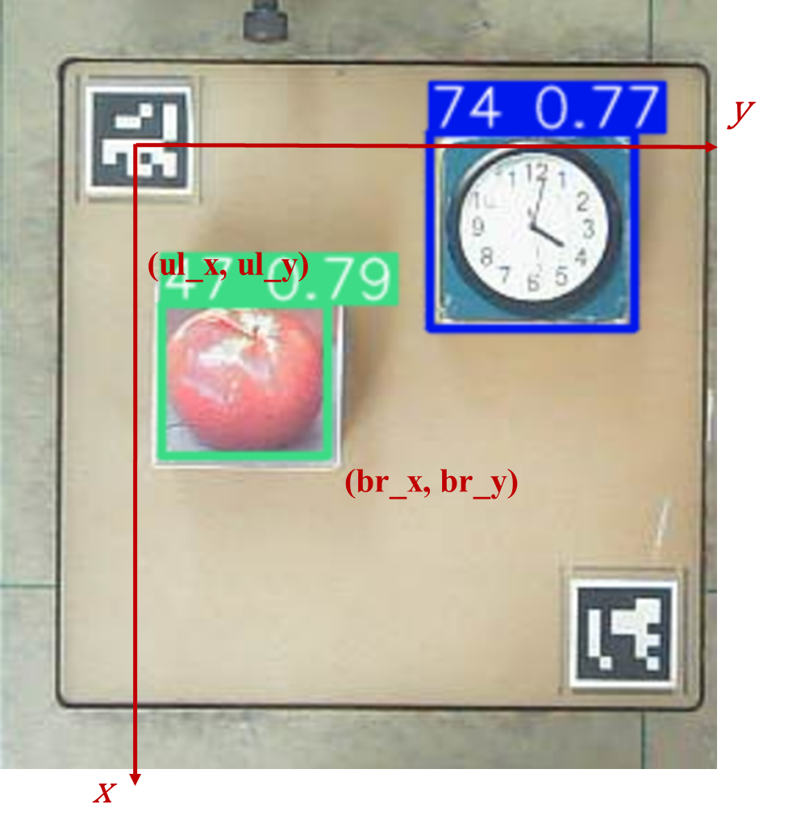
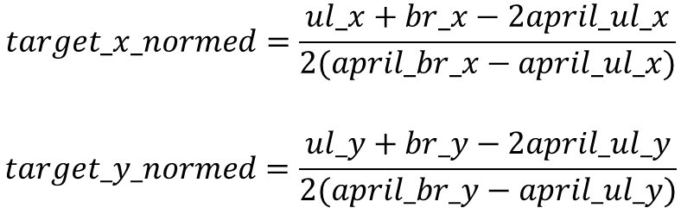
Robotic Arm - Coordinate Transformation
YOLO Location
Yolo will return the detected object’s top-left and bottom-right pixel coordinates (ul_x, ul_y, br_x, br_y), which are in the same coordinate system as apriltag.
Use relative coordinates (normalized) to control the robotic arm uniformly.
Relative coordinates (formed by two tags) are calculated as follows:

Slide 9
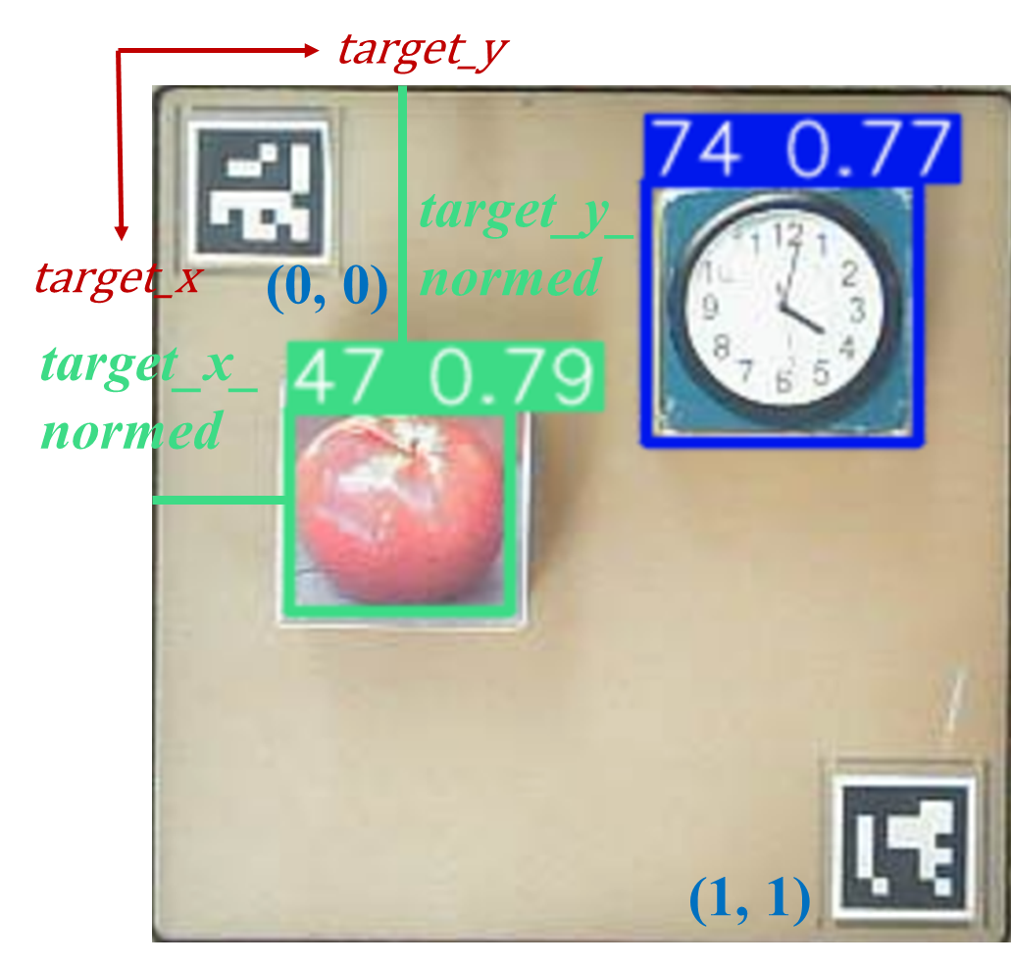
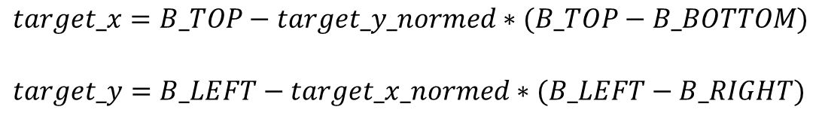
Robotic Arm - Coordinate Transformation
Robotic Arm Location
The calibration is performed based on the coordinates of two pre-determined AprilTags. It is known that the coordinates of the two tags in the robotic arm coordinate system are (B_TOP, B_LEFT) and (B_BOTTOM, B_RIGHT).
The default top-left corner is (0, 0), and the bottom-right corner is (1, 1).
The coordinates of the robotic arm (the first two axes in the six-axis coordinate system) are calculated as follows:
Attention: The relative coordinates here are opposite to the xy coordinates of the robotic arm!

Slide 10
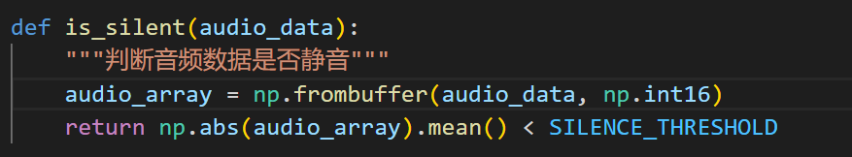
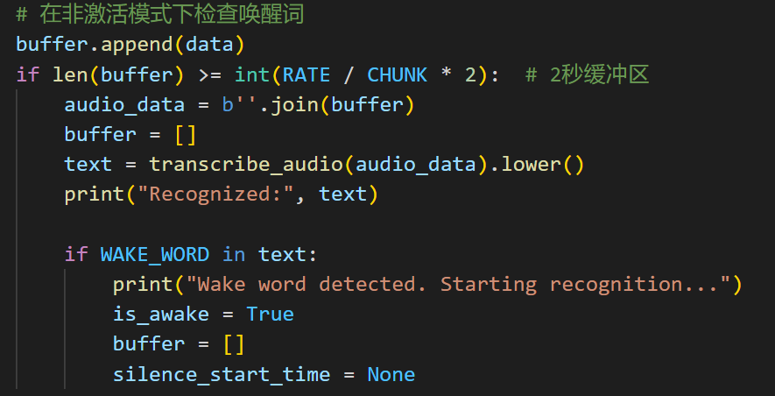
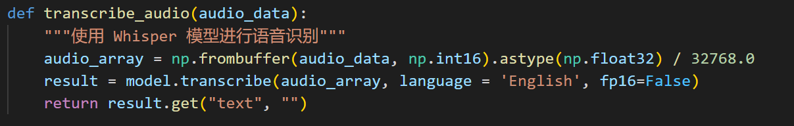
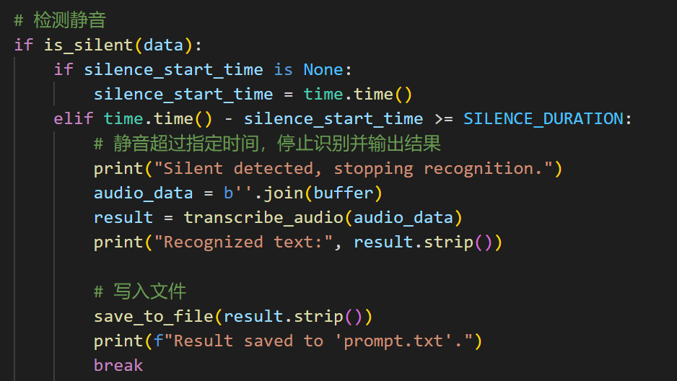
Audio —— Human Interaction
openai-whisper：Robust speech-to-text
is_silent(audio_data)：Silence detection
transcribe_audio(audio_data)
listen_and_recognize()

Slide 11
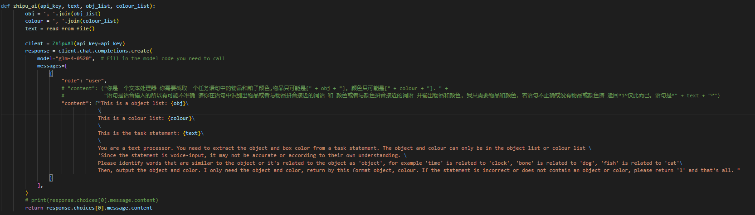
Audio —— Human Interaction
zhipuai：Robust Understanding

Slide 12
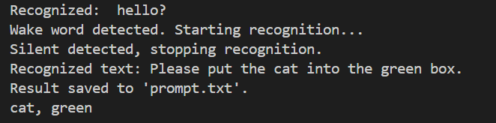
Audio —— Human Interaction
Example

Slide 13
Contribution
Audio: Song Chuan Lim
Proposal & Apriltag: Ziyi Chen
Match: Ziyi Chen, Song Chuan Lim
Robotic Arm: Yudong Xie, Ziyi Chen
Integration Test: Yudong Xie, Song Chuan Lim, Ziyi Chen

Slide 14
THE END & ENJOY THE DEMO
Song Chuan Lim, Ziyi Chen, Yudong Xie, Hao Chen
2024年12月23日

Slide 15
Demo

